Slide 1
Stage 3 Ready To Area 1 Course Designer: Chu Xu
Ready To Area 1 is a 36 round, 180 point, COMSTOCK Long course. There are 17 USPSA targets and 2 steel targets. The best 2 hits per cardboard target will score. Steel must fall to score.
Handgun start position is standing behind barrel with wrists below belt. Handgun is unloaded and lying flat and unsupported on the barrel. PCC start position is standing behind barrel, facing down range, PCC is unloaded and lying flat and unsupported on the barrel, muzzle pointed down range.
On the audible start signal, engage all targets from within the shooting areas or the top of the balance beams.

Slide 2
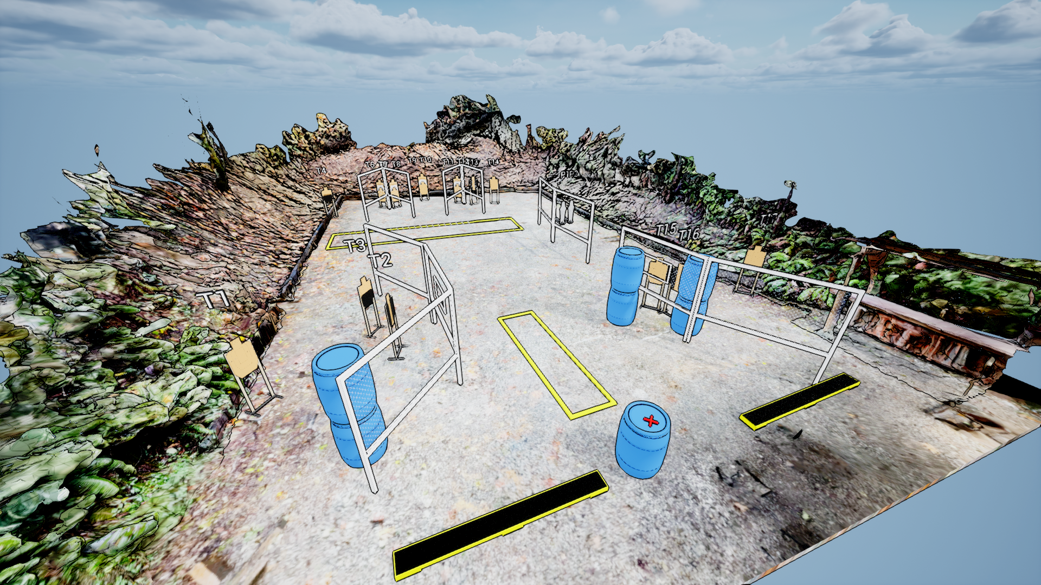
 | Stage 3 Ready To Area 1 Course Designer: Chu Xu

